Slide 1
Introduction to Structured Programming
Operators, conditional structures, and logical operators

Slide 2
Arithmetic operators
The arithmetic operators are:
Operator | Operation (integer) | Operation (real)
+ | addition | addition
- | subtraction | subtraction
* | multiplication | multiplication
/ | integer division | division
% | modulus

Slide 3
Examples
#include <iostream>
using namespace std;
int main()
{
int a = 4, b = 2;
cout << "The sum of a + b = " << a + b << endl;
cout << "The subtraction of a - b = " << a - b << endl;
cout << "The multiplication of a * b = " << a * b << endl;
cout << "The division of a / b = " << a / b << endl;
cout << "The modulus of a % b = " << a % b << endl;
system("pause");
return 0;
}

Slide 4
Important rules
When an arithmetic operation is applied, it is important to know what variable types are used in the operation. The following rules apply:
If at least one variable used in the arithmetic operation is of a real number type (float, double, or long double), then the operation’s result will be real.
If none of the variables is real, then the operation’s result will be an integer. This point is very important to understand, especially for integer division, which can result in loss of decimal precision.

Slide 5
Examples (integer division)
#include <iostream>
using namespace std;
int main()
{
int a = 10, b = 3;
double result;
result = a / b;
cout << "The result is: " << result << endl;
system("pause");
return 0;
}

Slide 6
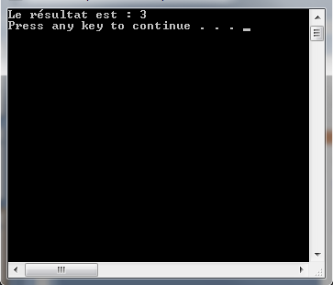
Examples (integer division)

Slide 7
Examples (integer division)
#include <iostream>
using namespace std;
int main()
{
double a = 10, b = 3;
double result;
result = a / b;
cout << "The result is: " << result << endl;
system("pause");
return 0;
}

Slide 8
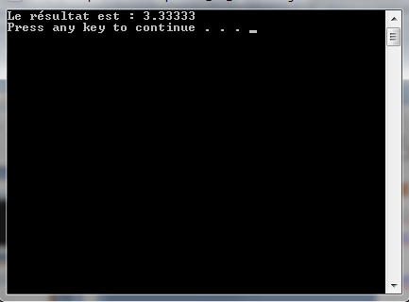
Examples (integer division)

Slide 9
Examples (integer division with casting)
#include <iostream>
using namespace std;
int main()
{
int a = 10, b = 3;
double result;
result = (double)a / b;
cout << "The result is: " << result << endl;
system("pause");
return 0;
}

Slide 10
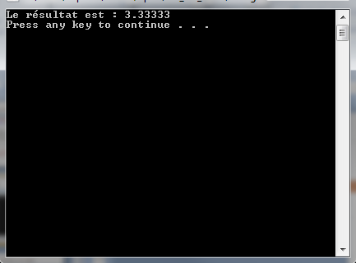
Examples (integer division with casting)

Slide 11
Relational operators
Relational operators in C are practically all the same as those seen in the course on programming logic – except for certain ones (= and <>), which in C are written differently but are otherwise equivalent.
Like when we use them in pseudocode, relational operators always return a boolean result (true or false).

Slide 12
Relational operators
The relational operators are:
Symbol | Meaning | Pseudocode equivalent
< | less than | <
<= | less than or equal to | <=
> | greater than | >
>= | greater than or equal to | >=
== | equal to | =
!= | not equal to (different than) | <>

Slide 13
Examples
#include <iostream>
using namespace std;
int main()
{
int a = 4, b = 2;
bool result;
result = a < b;
cout << "The result is: " << result << endl;
cout << "The result is: " << (a > b) << endl;
system("pause");
return 0;
}

Slide 14
Conditional structures
When writing pseudocode, we sometimes use the following structure:
IF condition THEN
procedure 1
ELSE IF condition THEN
procedure 2
ELSE
procedure 3
ENDIF

Slide 15
Conditional structures
In C++, we will use the following structure (very similar to the previous pseudocode structure):
if(condition(s)) // 1 : 1 cardinality {
procedure1;
}
else if(condition(s)) // 0 : N cardinality {
procedure2;
}
else // 0 : 1 cardinality {
procedure3;
}
Conditions are placed inside parentheses ( )
Procedures are placed inside braces { }

Slide 16
Conditional structures
#include <iostream>
using namespace std;
int main()
{
int age;
cout << "Enter your age: ";
cin >> age;
if (age >= 18)
{
cout << "You are an adult." << endl;
}
else
{
cout << "You are a minor." << endl;
}
return 0;
}

Slide 17
Conditional structures
#include <iostream>
using namespace std;
int main()
{
int grade;
cout << "Enter the grade: ";
cin >> grade;
if (grade >= 90) {
cout << "Grade is in A range." << endl;
}
else if (grade >= 80) {
cout << "Grade is in B range." << endl;
}
...
else if (grade < 60) {
cout << "Grade is in F range." << endl;
}
return 0;
}

Slide 18
Conditional structures
You can also place the an arithmetic operation’s result in a condition with no relational operator, following the rule on boolean variables seen last class:
#include <iostream>
using namespace std;
int main()
{
if (2 + 2)
{
cout << "This is a message." << endl;
}
system("pause");
return 0;
}

Slide 19
Conditional structures
It is equally possible to simply place a variable in a condition with no relational operator:
#include <iostream>
using namespace std;
int main()
{
int a = 0;
if (a)
{
cout << "This is a message." << endl;
}
system("pause");
return 0;
}

Slide 20
Conditional structures
Moreover, it is common to place only a bool variable in a condition with no relational operator:
#include <iostream>
using namespace std;
int main()
{
bool isRaining = true;
if (isRaining)
{
cout << "Bring an umbrella." << endl;
}
system("pause");
return 0;
}

Slide 21
Logical operators
In pseudocode, the logical operators (AND, OR, and NOT) could be used.
These can also be used in C/C++, but they are written differently:
Symbol | Meaning | Pseudocode equivalent
&& | Conjunction (logical AND) | AND (∧)
|| | Disjunction (logical OR) | OR (∨)
! | Negation (logical NOT) | NOT (¬)

Slide 22
Logical operators
#include <iostream>
using namespace std;
int main() {
bool isSnowing = true;
bool isCold = false;
if (isSnowing && isCold) {
cout << "Wear a tuque and tall boots." << endl;
}
else if (!isSnowing && isCold) {
cout << "Wear a tuque." << endl;
}
else if (isSnowing && !isCold) {
cout << "Wear high boots." << endl;
}
if (isSnowing || isCold) {
cout << "Wear a coat." << endl;
}
system("pause");
return 0;
}

Slide 23
Exercise
A manager of a bar wants an application that is able to determine whether or not a person can enter the bar.
If the person does not have a piece of identification, then they cannot enter.
Identification is not all that is needed. They also need to be at least as old as the local minimum legal drinking age, which is 18 years old in Québec.
Furthermore, the bar manager may need to be able to install the application outside of Québec, and in fact they are planning to install it in Ontario as well, where the legal drinking age is 19.
Make an application matching the above specifications. Using the information collected from the client, it must display a message indicating acceptance if the person is legally allowed to drink alcohol, and a message indicating rejection if the person is not allowed.

